Slide 1
William Stallings
Computer Organization and Architecture
10th Edition
Chapter 4
Cache Memory

Slide 2
Characteristics of Memory System
Location
Capacity
Unit of transfer
Access method
Performance
Physical type
Physical characteristics
Organisation
Notes:
The term location in refers to whether memory is internal and external to the computer

Slide 3
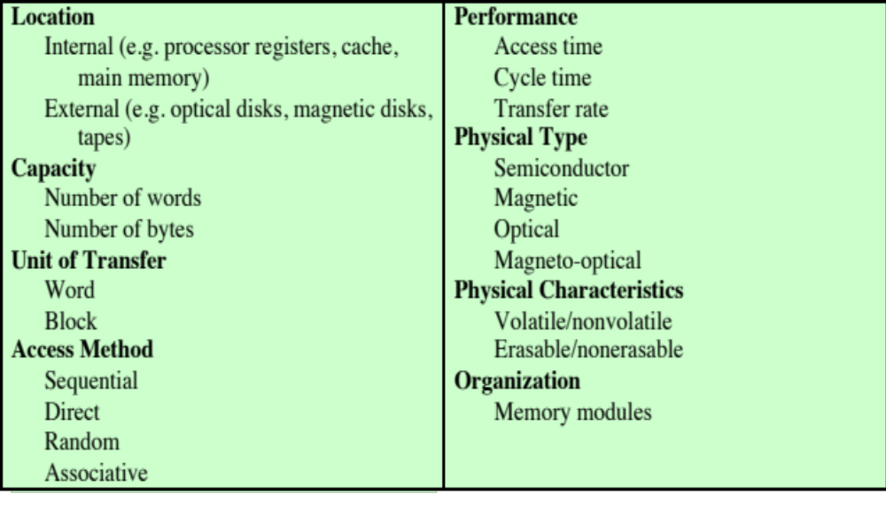
Characteristics of Memory System
Table 4.1
Key Characteristics of Computer Memory Systems
Notes:
The complex subject of computer memory is made more manageable if we classify
memory systems according to their key characteristics. The most important of these
are listed in Table 4.1.

Slide 4
Characteristics of Memory Systems
Location
  Refers to whether memory is internal and external to the computer
  Internal memory is often equated with main memory
  Processor requires its own local memory, in the form of registers
  Cache is another form of internal memory
  External memory consists of peripheral storage devices that are accessible to the processor via I/O controllers
Capacity
  Memory is typically expressed in terms of bytes
Notes:
The term location in Table 4.1 refers to whether memory is internal and external
to the computer. Internal memory is often equated with main memory. But there
are other forms of internal memory. The processor requires its own local memory, in
the form of registers (e.g., see Figure 2.3). Further, as we shall see, the control unit
portion of the processor may also require its own internal memory. We will defer
discussion of these latter two types of internal memory to later chapters. Cache is
another form of internal memory. External memory consists of peripheral storage
devices, such as disk and tape, that are accessible to the processor via I/O controllers.
An obvious characteristic of memory is its capacity. For internal memory, this is
typically expressed in terms of bytes (1 byte = 8 bits) or words. Common word lengths
are 8, 16, and 32 bits. External memory capacity is typically expressed in terms of bytes.
A related concept is the unit of transfer. For internal memory, the unit
of transfer is equal to the number of electrical lines into and out of the memory
module. This may be equal to the word length, but is often larger, such as 64, 128, or
256 bits. To clarify this point, consider three related concepts for internal memory:
• Word: The “natural” unit of organization of memory. The size of a word is typically
equal to the number of bits used to represent an integer and to the instruction
length. Unfortunately, there are many exceptions. For example, the CRAY
C90 (an older model CRAY supercomputer) has a 64-bit word length but uses
a 46-bit integer representation. The Intel x86 architecture has a wide variety of
instruction lengths, expressed as multiples of bytes, and a word size of 32 bits.
• Addressable units: In some systems, the addressable unit is the word. However,
many systems allow addressing at the byte level. In any case, the relationship
between the length in bits A of an address and the number N of addressable
units is 2^{A} = N.
• Unit of transfer: For main memory, this is the number of bits read out of or
written into memory at a time. The unit of transfer need not equal a word or
an addressable unit. For external memory, data are often transferred in much
larger units than a word, and these are referred to as blocks

Slide 5
Unit of Transfer
  For internal memory the unit of transfer is equal to the number of electrical lines into and out of the memory module
Internal
  Usually governed by data bus width
External
  Usually a block which is much larger than a word
Addressable unit
  Smallest location which can be uniquely addressed
  Word internally
  Cluster on M$ disks

Slide 6
Access Methods (1)
Sequential
  Start at the beginning and read through in order
  Access time depends on location of data and previous location
  e.g. tape
Direct
  Individual blocks have unique address
  Access is by jumping to some surrounding area plus sequential search
  Access time depends on location and previous location
  e.g. disk

Slide 7
Access Methods (2)
Random
  Individual addresses identify locations exactly
  Access time is independent of location or previous access
  e.g. RAM
Associative
  Data is located by a comparison with contents of a portion of the store
  Access time is independent of location or previous access
  e.g. cache

Slide 8
Performance
Access time
  Time between presenting the address and getting the valid data, for RAM time to perform read/write op
Memory Cycle time
  Time may be required for the memory (RAM) to “recover” (i.e. ACK, empty buffer) before next access
  Memory Cycle time = access time + recovery
Transfer Rate
  Rate at which data can be moved, or transferred into or out of a memory unit, for RAM is (1 / cycle time)

Slide 9

Memory
  The most common forms are:
  Semiconductor memory
  Magnetic surface memory
  Optical
  Magneto-optical
  Several physical characteristics of data storage are important:
  Volatile memory
    Information decays naturally or is lost when electrical power is switched off
  Nonvolatile memory
    Once recorded, information remains without deterioration until deliberately changed
    No electrical power is needed to retain information
  Magnetic-surface memories
    Are nonvolatile
  Semiconductor memory
    May be either volatile or nonvolatile
  Nonerasable memory
    Cannot be altered, except by destroying the storage unit
    Semiconductor memory of this type is known as read-only memory (ROM)
  For random-access memory the organization is a key design issue
  Organization refers to the physical arrangement of bits to form words
Notes:
A variety of physical types of memory have been employed. The most common
today are semiconductor memory, magnetic surface memory, used for disk and
tape, and optical and magneto-optical.
Several physical characteristics of data storage are important. In a volatile
memory, information decays naturally or is lost when electrical power is switched
off. In a nonvolatile memory, information once recorded remains without deterioration
until deliberately changed; no electrical power is needed to retain information.
Magnetic-surface memories are nonvolatile. Semiconductor memory (memory
on integrated circuits) may be either volatile or nonvolatile. Nonerasable memory
cannot be altered, except by destroying the storage unit. Semiconductor memory of
this type is known as read-only memory (ROM). Of necessity, a practical nonerasable
memory must also be nonvolatile.
For random-access memory, the organization is a key design issue. In this context,
organization refers to the physical arrangement of bits to form words. The
obvious arrangement is not always used, as is explained in Chapter 5.

Slide 10
Memory Hierarchy (1)
Design constraints on a computer’s memory can be summed up by three questions:
  How much, how fast, how expensive
There is a trade-off among capacity, access time, and cost
  Faster access time, greater cost per bit
  Greater capacity, smaller cost per bit
  Greater capacity, slower access time
The way out of the memory dilemma is not to rely on a single memory component or technology, but to employ a memory hierarchy
Notes:
The design constraints on a computer’s memory can be summed up by three questions:
How much? How fast? How expensive?
The question of how much is somewhat open ended. If the capacity is there,
applications will likely be developed to use it. The question of how fast is, in a sense,
easier to answer. To achieve greatest performance, the memory must be able to
keep up with the processor. That is, as the processor is executing instructions, we
would not want it to have to pause waiting for instructions or operands. The final
question must also be considered. For a practical system, the cost of memory must
be reasonable in relationship to other components.
As might be expected, there is a trade-off among the three key characteristics
of memory: capacity, access time, and cost. A variety of technologies are used to
implement memory systems, and across this spectrum of technologies, the following
relationships hold:
• Faster access time, greater cost per bit
• Greater capacity, smaller cost per bit
• Greater capacity, slower access time
The dilemma facing the designer is clear. The designer would like to use memory
technologies that provide for large-capacity memory, both because the capacity
is needed and because the cost per bit is low. However, to meet performance
requirements, the designer needs to use expensive, relatively lower-capacity memories
with short access times.
The way out of this dilemma is not to rely on a single memory component or
technology, but to employ a memory hierarchy.

Slide 11
Memory Hierarchy (2)
Registers
  In CPU
Internal or Main memory
  May include one or more levels of cache
  “RAM”
External memory
  Backing store

Slide 12
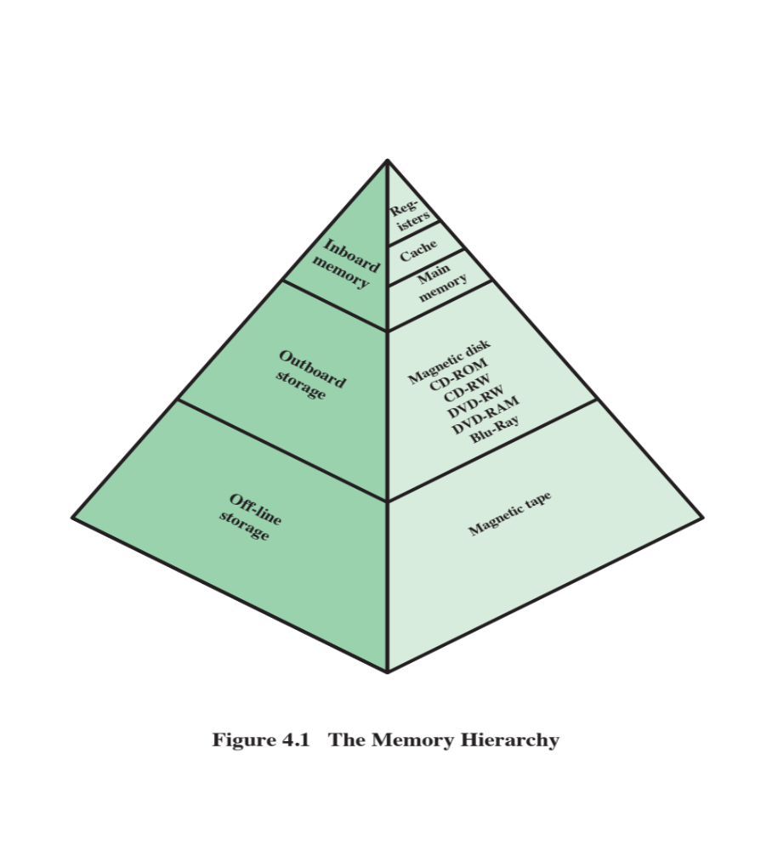
Memory Hierarchy - Diagram

Slide 13
Memory
The use of three levels exploits the fact that semiconductor memory comes in a variety of types which differ in speed and cost
Data are stored more permanently on external mass storage devices
External, nonvolatile memory is also referred to as secondary memory or auxiliary memory
Cache
  A portion of main memory can be used as a buffer to hold data temporarily that is to be read out to disk
  A few large transfers of data can be used instead of many small transfers of data
  Data can be retrieved rapidly from the cache rather than slowly from the disk
Notes:
The three forms of memory just described are, typically, volatile and employ
semiconductor technology. The use of three levels exploits the fact that semiconductor
memory comes in a variety of types, which differ in speed and cost. Data are
stored more permanently on external mass storage devices, of which the most common
are hard disk and removable media, such as removable magnetic disk, tape,
and optical storage. External, nonvolatile memory is also referred to as secondary
memory or auxiliary memory . These are used to store program and data files and
are usually visible to the programmer only in terms of files and records, as opposed
to individual bytes or words. Disk is also used to provide an extension to main memory
known as virtual memory, which is discussed in Chapter 8.
Other forms of memory may be included in the hierarchy. For example, large
IBM mainframes include a form of internal memory known as expanded storage.
This uses a semiconductor technology that is slower and less expensive than that
of main memory. Strictly speaking, this memory does not fit into the hierarchy but
is a side branch: Data can be moved between main memory and expanded storage
but not between expanded storage and external memory. Other forms of secondary
memory include optical and magneto-optical disks. Finally, additional levels can be
effectively added to the hierarchy in software. A portion of main memory can be
used as a buffer to hold data temporarily that is to be read out to disk. Such a technique,
sometimes referred to as a disk cache, improves performance in two ways:
■ Disk writes are clustered. Instead of many small transfers of data, we have
a few large transfers of data. This improves disk performance and minimizes
processor involvement.
■ Some data destined for write-out
may be referenced by a program before the
next dump to disk. In that case, the data are retrieved rapidly from the software
cache rather than slowly from the disk.
Appendix 4A examines the performance implications of multilevel memory
structures.

Slide 14
Physical Characteristics
Volatility - information is lost when electrical power is switched off (e.g. RAM, Cache)
Non-volatile (Erasable) - information once recorded remains without deterioration until deliberately changed, no power is needed to retain information

Slide 15

Cache Memory
Small amount of fast memory
Sits between normal main memory and CPU
May be located on CPU chip or module
Cache contains a copy of portions of main memory
Single Cache

Slide 16
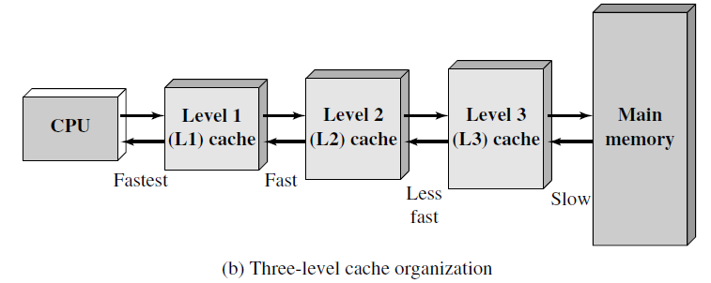
Cache Memory
use of multiple levels of cache
L2 cache is slower and typically larger than the L1 cache
and the L3 cache is slower and typically larger than the L2 cache

Slide 17
Cache operation - overview
CPU requests contents of memory location
Check cache for this data
If present, get from cache (fast)
If not present, read required block from main memory to cache
Then deliver from cache to CPU Memory address
Cache includes tags to identify which block of main memory is in each cache Line
0
1
2
3
2^{n} -1
o o o
Line No. Tag Block
Block
(K Words)
Main memory consists of up to 2^{n} addressable words
each word having a unique n-bit address, memory consists of a no. of fixed-length blocks of K words each, i.e. M = (2^{n} / K) blocks
Cache consists of C Lines of K words each, and C << M
Tag is usually a portion of main memory address
0
1
2
C -1
 | o o o
Block
Block Length
(K Words)
(a) Cache
Word Length
(b) Main Memory

Slide 18
Cache Read Operation – Overview
START
Receive address
RA from CPU
Is block
Containing RA
In cache?
No
Access main
memory for block
containing RA
Yes
Fetch RA word
and deliver
to CPU
Allocate cache
line for main
memory block
Load main memory
block into cache line
Deliver RA word
to CPU
DONE
Cache Read Operation

Slide 19

Typical Cache Organization
Cache connects to processor via data, control & address lines. Data & address lines also attach to data & address buffers, which attach to a system bus from which main memory is reached
when a cache hit occurs, data & address buffers are disabled & communication is only b/w processor & cache, with no system bus traffic
when a cache miss occurs, desired address is loaded onto system bus & data are returned through data buffer to both cache & processor parallelly
but in some org desired word is first read into cache & then transferred from cache to processor

Slide 20
Elements of Cache Design
Cache Size
Mapping Function (Direct, Associate, Set associate)
Replacement Algorithm (LRU, FIFO, LFU, Random)
Write Policy (Write through, Write back, Write one)
Line Size
Number of Caches (Single or two levels, Unified/Split)

Slide 21
Cache Size
Cost
  More cache is expensive
Speed
  More cache is faster (up to a point)
  Checking cache for data takes time

Slide 22
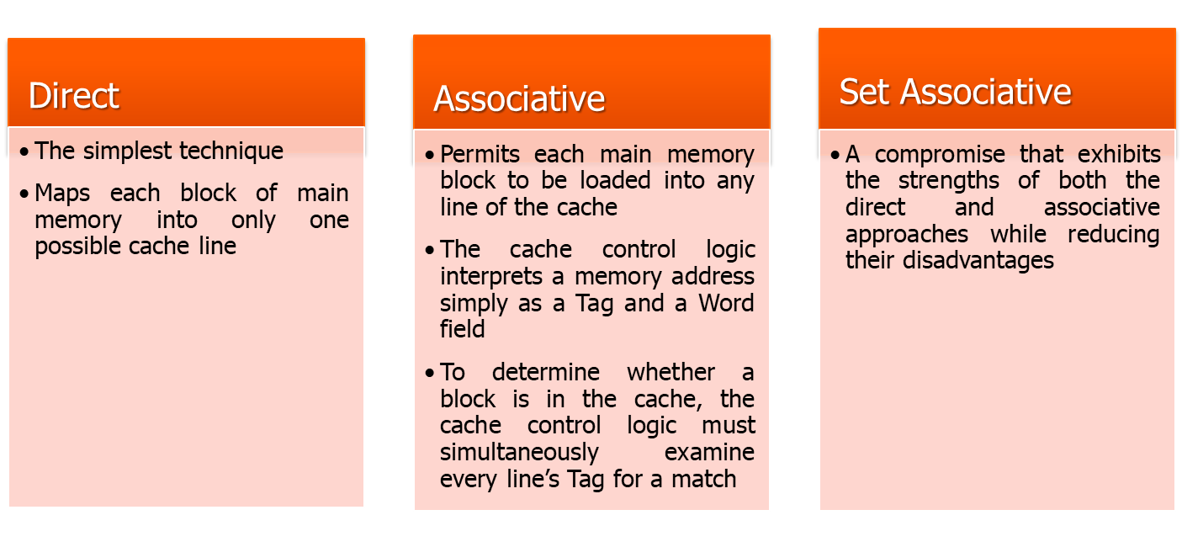
Mapping Function
Because there are fewer cache lines than main memory blocks, an algorithm is needed for mapping main memory blocks into cache lines
Three techniques can be used:
Notes:
Because there are fewer cache lines than main memory blocks, an algorithm is
needed for mapping main memory blocks into cache lines. Further, a means is
needed for determining which main memory block currently occupies a cache line.
The choice of the mapping function dictates how the cache is organized. Three
techniques can be used: direct, associative, and set associative.
Direct mapping: The simplest technique, known as direct mapping, maps each
block of main memory into only one possible cache line.
Associative mapping: Associative mapping overcomes the disadvantage of direct
mapping by permitting each main memory block to be loaded into any line of the
cache.
Set-associative mapping: Set-associative mapping is a compromise that
exhibits the strengths of both the direct and associative approaches while reducing
their disadvantages.

Slide 23
Mapping Function (Example)
As there are fewer cache lines than main memory blocks, an algorithm is needed for mapping main memory blocks into cache lines. For example,
Cache of 64kByte
Cache block/line of 4 bytes
  i.e. cache is 16k (2¹⁴) lines of 4 bytes
16MBytes main memory
With each byte directly addressable by a 24 bit address, (2²⁴=16M),
Thus for mapping purpose we can consider main memory to consist of 4M blocks of 4 bytes each

Slide 24
1. Direct Mapping
Each block of main memory maps to only one cache line
  i.e. if a block is in cache, it must be in one specific place
Address is in two parts
Least Significant w bits identify unique word
Most Significant s bits specify one memory block
The MSBs are split into a cache line field r and a tag of s-r (most significant)

Slide 25
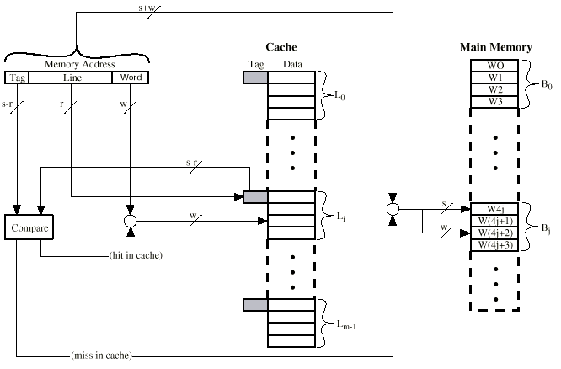
Direct Mapping Cache Organization
First specific Line Index is calculated (go to particular Line)
Then Line’s Tag is compared

Slide 26
Direct Mapping
Address Structure
Tag s-r
Line or Slot r
Word w
8
14
2
24 bit address
2 bit word identifier (4 byte block)
22 bit block identifier
  8 bit tag (=22-14)
  14 bit slot or line
No two blocks in the same line have the same Tag field
Check contents of cache by finding (first calculating index of a particular) line and then checking (comparing) Tag currently stored in that line, in the end one of the 4 words

Slide 27
Direct Mapping Summary
Address length = (s + w) bits
Number of addressable units = 2^{s+w} words or bytes
Block size = line size = 2^{w} words or bytes
Number of blocks in main memory = 2^{s+ w}/2^{w} = 2^{s}
Number of lines in cache = m = 2^{r} or 16k (2¹⁴) lines
Size of tag = (s – r) bits

Slide 28
Direct Mapping
Cache Line Table
Blocks of main memory are assigned to lines of cache as follows:
Cache Line Main Memory blocks assign
0 0, m, 2m, 3m … 2^{s}-m
1 1, m+1, 2m+1 … 2^{s}-m+1
. .
. .
m-1 m-1, 2m-1, 3m-1 … 2^{s}-1
0 000000, 010000, …. FF0000
1 000004, 010004, …. FF0004
. .
2¹⁴ – 1 00FFFC, 01FFFC, …. FFFFFC
Blocks with starting addresses 000000, 010000, …. FF0000 have tag numbers 00, 01, …. FF
Cache Line | Starting memory address of block

Slide 29
Direct Mapping
Cache Line Table
0
1
2
.
.
m-1
m
.
.
2m-1
2m
.
.
3m-1
3m
.
.
.
2^{s}-1
000000
016000
0
1
2
.
.
.
250-1
Tag Block Line No.
0
0
0-249 | 0, m, 2m, 3m … 2s-m
0-249
0-249
- - - | o o o
0-249
0
1
2
m -1
m+1
0
0
032000
2m+1
0
0
m = 16 k = 16000 (Lines)
(a) Cache
048000
0
0
0
0
4M = 4x10⁶ (blocks)
(b) Main Memory

Slide 30
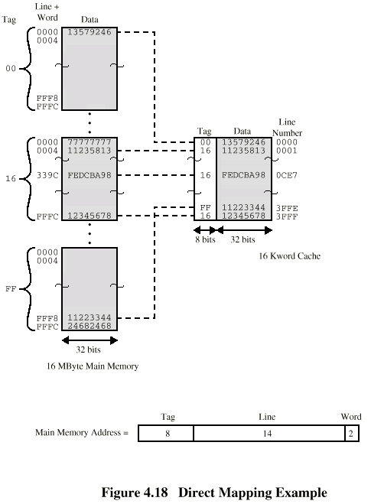
Direct Mapping Example
8-bit 14-bit 2-bit
1 6 F F F C
1 6 F F F C (hex)
0001 0110 1111 1111 1111 1100 (binary)
11 1111 1111 1111
3 F F F

Slide 31
Direct Mapping pros & cons
Simple
Inexpensive
Fixed location for given block (disadvantage)
  If a program accesses 2 blocks that map to the same line repeatedly, cache misses are very high, then blocks will be continually swapped in the cache

Slide 32
2. Associative Mapping
A main memory block can load into any line of cache
Memory address is interpreted as tag and word
The Tag field uniquely identifies a block of main memory
Every line’s tag is examined for a match
Cache searching gets expensive
Tag 22-bit
Word
2-bit

Slide 33
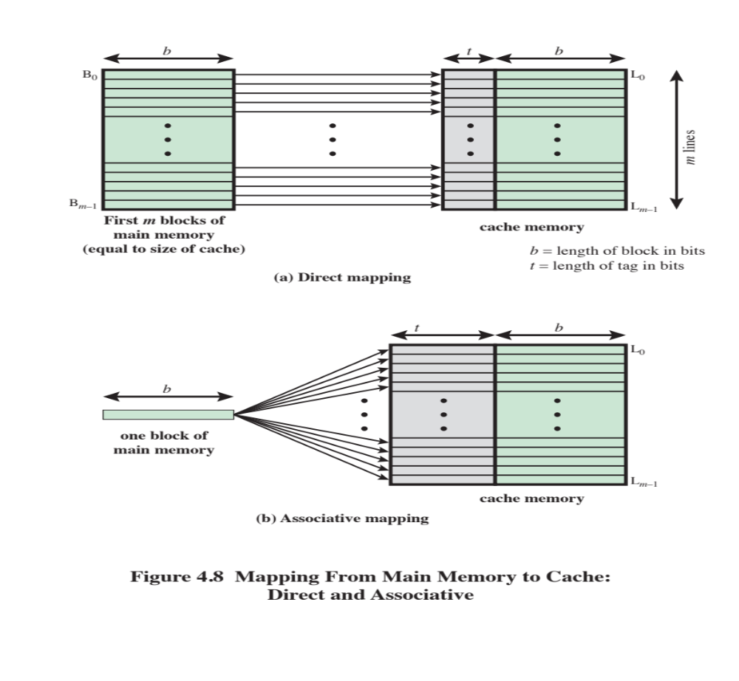
Notes:
The mapping is expressed as
i = j modulo m
where
i = cache line number
j = main memory block number
m = number of lines in the cache
Figure 4.8a shows the mapping for the first m blocks of main memory. Each
block of main memory maps into one unique line of the cache. The next m blocks
of main memory map into the cache in the same fashion; that is, block B_{m} of main
memory maps into line L₀ of cache, block _{Bm+1} maps into line L₁, and so on.

Slide 34
Associative Mapping Summary
Address length = (s + w) bits
Number of addressable units = 2^{s+w} words or bytes
Block size = line size = 2^{w} words or bytes
Number of blocks in main memory = 2^{s+ w}/2^{w} = 2^{s}
Size of tag = s bits

Slide 35

Fully Associative Cache Organization

Slide 36
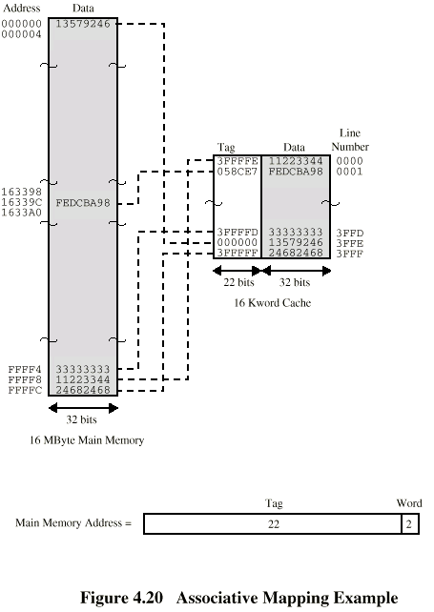
Associative Mapping Example

Slide 37
Associative Mapping
Address Structure
Tag 22 bit
Word
2 bit
22 bit tag stored with each 32 bit block of data
Compare tag field with tag entry in cache to check for hit
Least significant 2 bits of address identify which 8 bit word is required from 32 bit data block, e.g.
The 24-bit hex address 16339C has the 22-bit tag 058CE7 i.e.,
Memory Address 0001 0110 0011 0011 1001 1100 (binary)
1 6 3 3 9 C (hex)
Tag(22-bits) 00 0101 1000 1100 1110 0111 (binary)
0 5 8 C E 7 (hex)
- There is flexibility as to which block to replace when new block is read into cache, using replacement algorithm, to maximize hit ratio
- There is complex circuitry required to examine tags of all cache lines

Slide 38
3. Set Associative Mapping
Cache is divided into a number of sets
Each set contains a number of lines
A given main memory block maps to any cache line in a given set
  e.g. Block B can be in any line of set i (but block B in only one set)
e.g. 2 lines per set
  2 way associative mapping
  A given block can be in one of 2 lines in only one set

Slide 39
Set Associative Mapping
Cache is divided into v sets, each of which consists of k lines
2-way associative mapping, or 2-Lines per set
0
1
2
3
2^{n} -1
W0
W1
W2
W3
o o o
Line No. Tag Block
Block 0
(4-Words)
0
1
2
4
m-2
m-1
 | Line 0
 | Line 1
 | Line 2
 | Line 3
 | o o o
 | Line m-2
 | Line m-1
Set 0
Set 1
Set v
Block j
Word Length
(b) Main Memory
Block Length
(K Words)
(a) Cache

Slide 40
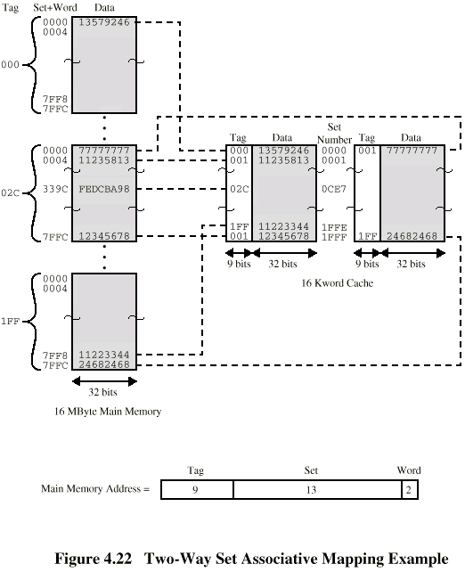
Two Way Set Associative Mapping Address Structure
Address length = (s + w) bits
Number of addressable units = 2^{s+w} words or bytes
Block size = line size = 2^{w} words or bytes
Number of blocks in main memory = 2^{s}
Number of lines in set = k or 2
Number of sets = v = 2^{d} or 2¹³ or 8000
Number of lines in cache = k v = k * 2^{d}
Size of tag = (s – d) bits or 9-bit, e.g. 1FF7FFC
1 F F 7 F F C
1 1 1 1 1 1 1 1 1 1 1 1 1 1 1 1 1 1 1 1 1 1 0 0
Tag
Set
Word
9-bit 13-bit 2-bit

Slide 41
Set Associative Mapping
Example
13 bit set number identifies a unique set of two lines within cache
It gives no. of blocks in main memory, modulo 2¹³ and mapping of blocks into lines, thus blocks numbers
000000, 008000, 016000, 024000 … of main memory map into same cache set 0 (Line 0 or Line 1)
Any of those blocks can be loaded into either of two lines in the set 0
But no two blocks that map into same cache set have same tag number
For read op 13-bit set no is used to determine which set of two lines is to be examined, then both lines in set are examined for a match with the tag no of address to be accessed

Slide 42
Set Associative Mapping
Example
0
1
2
.
.
v-1
v
.
.
2v-1
2v
.
.
3v-1
3v
.
.
.
2^{s}-1
000000
008000
0
1
2
.
.
.
500-1
Line No. Tag Block
0
1
2
4
m-2
m-1
 | Line 0
 | Line 1
 | Line 2
 | Line 3
 | o o o
 | Line m-2
 | Line m-1
0
0
Set 0
v+1
Set 1
0
0
016000
2v+1
Set v-1
0
0
m = 16 k = 8000 Sets (v) = 1FFF Sets
(a) Cache
024000
0
0
0
0
4M = 4x10⁶ (blocks)
(b) Main Memory

Slide 43
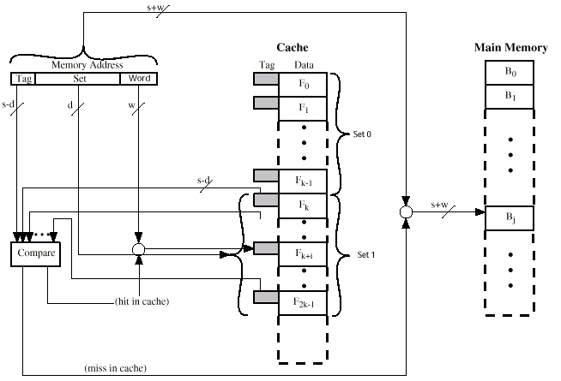
K-Way Set Associative Cache Organization

Slide 44
Two Way Set Associative Mapping Example
Tag
Set
Word
9-bit 13-bit 2-bit
1 F F 7 F F C
1 1 1 1 1 1 1 1 1 1 1 1 1 1 1 1 1 1 1 1 1 1 0 0
Use set field to determine cache set to look in
Compare tag field to see if we have a hit, e.g. from above, extract set field
1 F F F
1 1111 1111 1111
Address Tag Data Set no
1FF7FFC 1FF 24682468 1FFF
1FF7FF8 1FF 11223344 1FFE

Slide 45
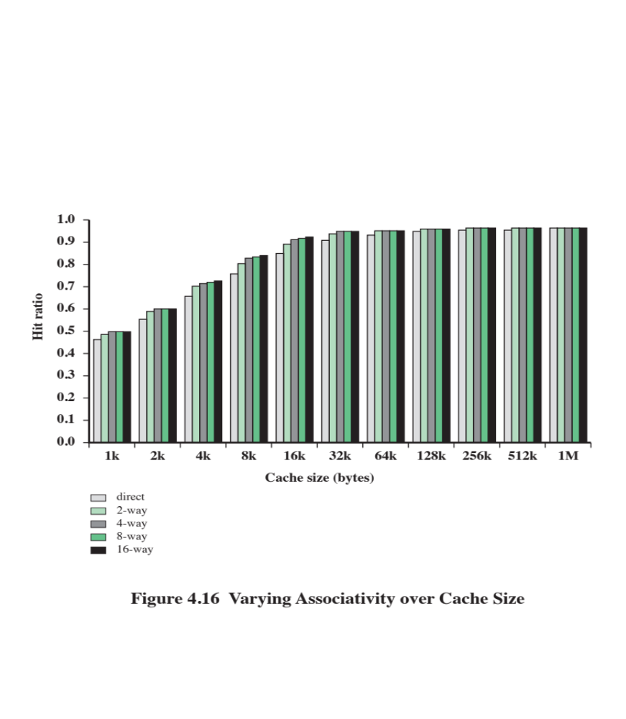
Performance is significant up to at least a cache size of 64KB
Difference between 2way and 4way at 4kB is much less than difference in going from
for 4kB to 8kB in cache size
Beyond about 32KB, increase in cache size brings no significant increase in performance
Notes:
Figure 4.16 shows the results of one simulation study of set-associative cache
performance as a function of cache size [GENU04]. The difference in performance
between direct and two-way set associative is significant up to at least a cache size of
64 kB. Note also that the difference between two-way and four-way at 4 kB is much
less than the difference in going from for 4 kB to 8 kB in cache size. The complexity
of the cache increases in proportion to the associativity, and in this case would not
be justifiable against increasing cache size to 8 or even 16 Kbytes. A final point to
note is that beyond about 32 kB, increase in cache size brings no significant increase
in performance.
The results of Figure 4.16 are based on simulating the execution of a GCC
compiler. Different applications may yield different results. For example, [CANT01]
reports on the results for cache performance using many of the CPU2000 SPEC
benchmarks. The results of [CANT01] in comparing hit ratio to cache size follow
the same pattern as Figure 4.16, but the specific values are somewhat different.

Slide 46
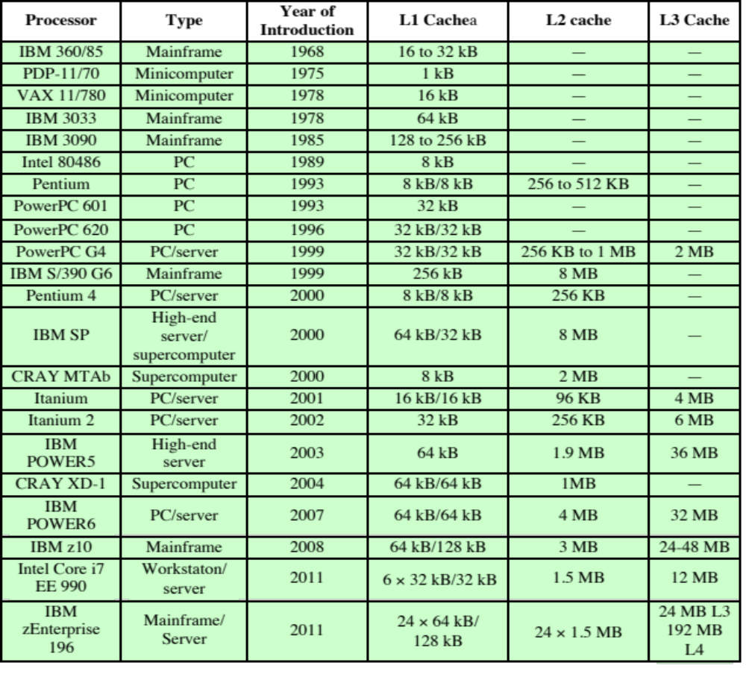
Table 4.3
Cache Sizes of Some Processors
ª Two values separated by a slash refer to instruction and data caches.
^{b} Both caches are instruction only; no data caches.
(Table can be found on page 134 in the textbook.)
Notes:
The first item in Table 4.2, cache size, has already been discussed. We would like the
size of the cache to be small enough so that the overall average cost per bit is close
to that of main memory alone and large enough so that the overall average access
time is close to that of the cache alone. There are several other motivations for
minimizing cache size. The larger the cache, the larger the number of gates involved
in addressing the cache. The result is that large caches tend to be slightly slower
than small ones—even when built with the same integrated circuit technology and
put in the same place on chip and circuit board. The available chip and board area
also limits cache size. Because the performance of the cache is very sensitive to the
nature of the workload, it is impossible to arrive at a single “optimum” cache size.
Table 4.3 lists the cache sizes of some current and past processors.

Slide 47
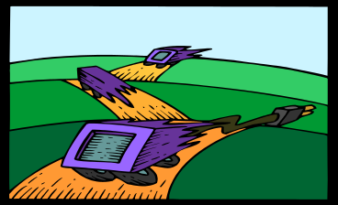
Replacement Algorithms (1)
Once the cache has been filled, when a new block is brought into the cache, one of the existing blocks must be replaced
For direct mapping there is only one possible line for any particular block and no choice is possible
For the associative and set-associative techniques a replacement algorithm is needed
To achieve high speed, an algorithm must be implemented in hardware
Notes:
Once the cache has been filled, when a new block is brought into the cache, one
of the existing blocks must be replaced. For direct mapping, there is only one possible
line for any particular block, and no choice is possible. For the associative
and set-associative techniques, a replacement algorithm is needed. To achieve high
speed, such an algorithm must be implemented in hardware.

Slide 48
Replacement Algorithms (2)
Associative & Set Associative
Hardware implemented algorithm (to achieve high speed)
Least Recently Used (LRU)
Replace that block in the set that has been in the cache longest with no reference to it
  Probably the most effective is LRU
e.g., in 2-way set associative
  Which of the 2 block is least recently used?
  Each line includes a USE bit, when a line is referenced, its USE bit is set to 1 and USE bit of other line in that set is set to 0. When a block is to be replaced into set, the line whose USE bit is 0 is replaced
  LRU should give the best hit ratio

Slide 49
Replacement Algorithms (3)
Associative & Set Associative
FIFO (First-in First-out)
Replace that block in the set that has been in the cache longest, it is easily implemented as a round-robin or circular buffer technique
LFU (Least frequently used)
Replace that block in the set that has experienced the fewest references, it could be implemented by associating a counter with each line
Random
A technique not based on usage is to pick a line at random from among the candidate lines, it provides only slightly inferior performance to an algorithm based on usage

Slide 50
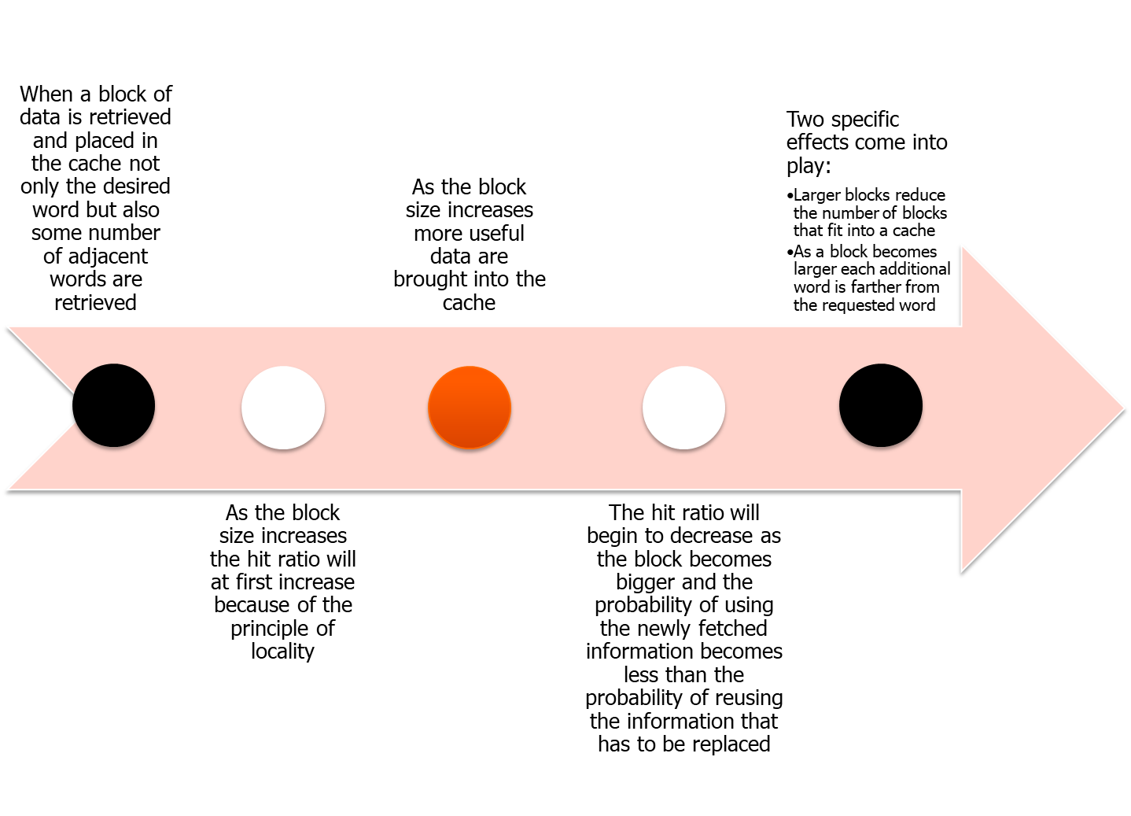
Line Size
Notes:
Another design element is the line size. When a block of data is retrieved and placed
in the cache, not only the desired word but also some number of adjacent words are
retrieved. As the block size increases from very small to larger sizes, the hit ratio
will at first increase because of the principle of locality, which states that data in the
vicinity of a referenced word are likely to be referenced in the near future. As the
block size increases, more useful data are brought into the cache. The hit ratio will
begin to decrease, however, as the block becomes even bigger and the probability
of using the newly fetched information becomes less than the probability of reusing
the information that has to be replaced. Two specific effects come into play:
• Larger blocks reduce the number of blocks that fit into a cache. Because each
block fetch overwrites older cache contents, a small number of blocks results
in data being overwritten shortly after they are fetched.
• As a block becomes larger, each additional word is farther from the requested
word and therefore less likely to be needed in the near future.
The relationship between block size and hit ratio is complex, depending on
the locality characteristics of a particular program, and no definitive optimum value
has been found. A size of from 8 to 64 bytes seems reasonably close to optimum
[SMIT87, PRZY88, PRZY90, HAND98]. For HPC systems, 64- and 128-byte cache
line sizes are most frequently used.

Slide 51
Multilevel Caches
As logic density has increased it has become possible to have a cache on the same chip as the processor
The on-chip cache reduces the processor’s external bus activity and speeds up execution time and increases overall system performance
  When the requested instruction or data is found in the on-chip cache, the bus access is eliminated
  On-chip cache accesses will complete appreciably faster than would even zero-wait state bus cycles
  During this period the bus is free to support other transfers
External cache is still desirable? (answer is yes), as Two-level cache includes:
  Internal cache designated as level 1 (L1)
  External cache designated as level 2 (L2)
Use of a second-level cache does improve performance, however use of multilevel caches complicates all of the design issues related to caches, including size, replacement algorithm, and write policy
Notes:
As logic density has increased, it has become possible to
have a cache on the same chip as the processor: the on-chip cache. Compared with
a cache reachable via an external bus, the on-chip cache reduces the processor’s
external bus activity and therefore speeds up execution times and increases overall
system performance. When the requested instruction or data is found in the on-chip
cache, the bus access is eliminated. Because of the short data paths internal to
the processor, compared with bus lengths, on-chip cache accesses will complete
appreciably faster than would even zero-wait state bus cycles. Furthermore, during
this period the bus is free to support other transfers.
The inclusion of an on-chip cache leaves open the question of whether an
off-chip, or external, cache is still desirable. Typically, the answer is yes, and most contemporary
designs include both on-chip and external caches. The simplest such organization
is known as a two-level cache, with the internal cache designated as level 1 (L1)
and the external cache designated as level 2 (L2). The reason for including an L2 cache
is the following: If there is no L2 cache and the processor makes an access request
for a memory location not in the L1 cache, then the processor must access DRAM or
ROM memory across the bus. Due to the typically slow bus speed and slow memory
access time, this results in poor performance. On the other hand, if an L2 SRAM (static
RAM) cache is used, then frequently the missing information can be quickly retrieved.
If the SRAM is fast enough to match the bus speed, then the data can be accessed
using a zero-wait state transaction, the fastest type of bus transfer.
Two features of contemporary cache design for multilevel caches are noteworthy.
First, for an off-chip L2 cache, many designs do not use the system bus as
the path for transfer between the L2 cache and the processor, but use a separate
data path, so as to reduce the burden on the system bus. Second, with the continued
shrinkage of processor components, a number of processors now incorporate the L2
cache on the processor chip, improving performance.
The potential savings due to the use of an L2 cache depends on the hit rates
in both the L1 and L2 caches. Several studies have shown that, in general, the use
of a second-level cache does improve performance (e.g., see [AZIM92], [NOVI93],
[HAND98]). However, the use of multilevel caches does complicate all of the design
issues related to caches, including size, replacement algorithm, and write policy; see
[HAND98] and [PEIR99] for discussions.

Slide 52
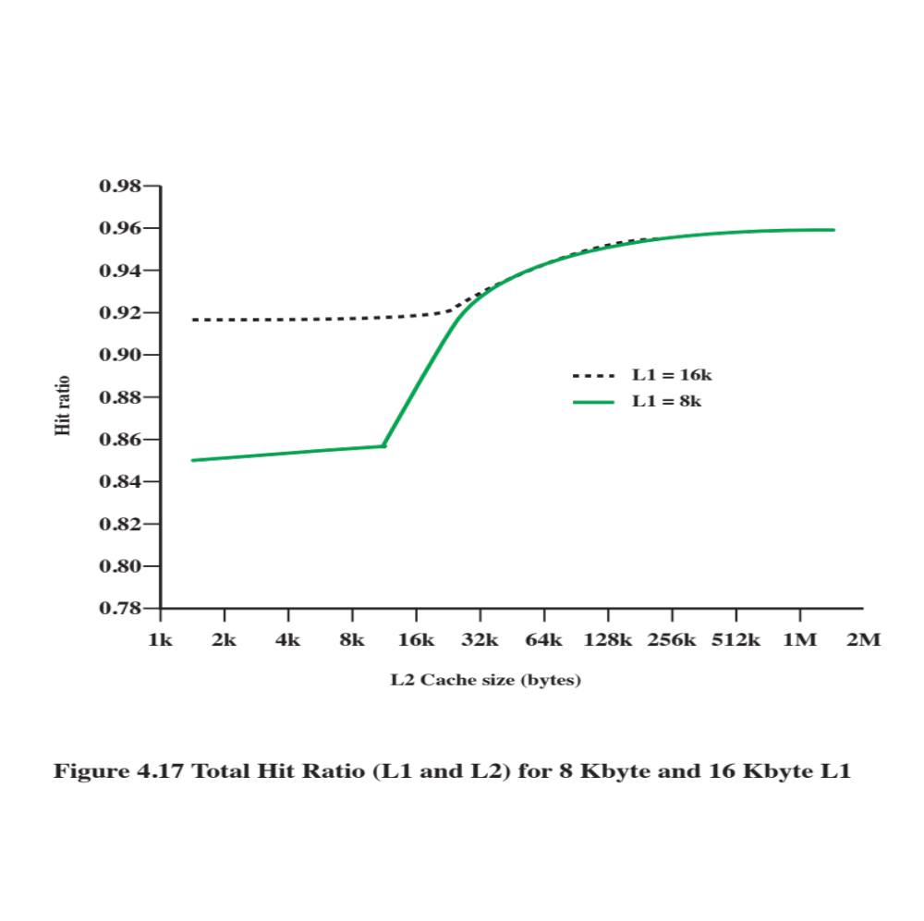
Notes:
Figure 4.17 shows the results of one simulation study of two-level cache performance
as a function of cache size [GENU04]. The figure assumes that both
caches have the same line size and shows the total hit ratio. That is, a hit is counted
if the desired data appears in either the L1 or the L2 cache. The figure shows the
impact of L2 on total hits with respect to L1 size. L2 has little effect on the total
number of cache hits until it is at least double the L1 cache size. Note that the steepest
part of the slope for an L1 cache of 8 Kbytes is for an L2 cache of 16 Kbytes.
Again for an L1 cache of 16 Kbytes, the steepest part of the curve is for an L2 cache
size of 32 Kbytes. Prior to that point, the L2 cache has little, if any, impact on total
cache performance. The need for the L2 cache to be larger than the L1 cache to
affect performance makes sense. If the L2 cache has the same line size and capacity
as the L1 cache, its contents will more or less mirror those of the L1 cache.
With the increasing availability of on-chip area available for cache, most contemporary
microprocessors have moved the L2 cache onto the processor chip and
added an L3 cache. Originally, the L3 cache was accessible over the external bus.
More recently, most microprocessors have incorporated an on-chip L3 cache. In
either case, there appears to be a performance advantage to adding the third level
(e.g., see [GHAI98]). Further, large systems, such as the IBM mainframe zEnterprise
systems, now incorporate 3 on-chip cache levels and a fourth level of cache
shared across multiple chips [CURR11].

Slide 53
Unified Versus Split Caches
Has become common to split cache:
  One dedicated to instructions
  One dedicated to data
  Both exist at the same level, typically as two L1 caches
Advantages of unified cache:
  Higher hit rate
    Balances load of instruction and data fetches automatically
    Only one cache needs to be designed and implemented
Trend is toward split caches at the L1 and unified caches for higher levels
Advantages of split cache:
  Eliminates cache contention between instruction fetch/decode unit and execution unit
    Important in pipelining
Notes:
When the on-chip cache first made an appearance,
many of the designs consisted of a single cache used to store references to both data
and instructions. More recently, it has become common to split the cache into two:
one dedicated to instructions and one dedicated to data. These two caches both exist
at the same level, typically as two L1 caches. When the processor attempts to fetch an
instruction from main memory, it first consults the instruction L1 cache, and when the
processor attempts to fetch data from main memory, it first consults the data L1 cache.
There are two potential advantages of a unified cache:
• For a given cache size, a unified cache has a higher hit rate than split caches
because it balances the load between instruction and data fetches automatically.
That is, if an execution pattern involves many more instruction fetches
than data fetches, then the cache will tend to fill up with instructions, and if an
execution pattern involves relatively more data fetches, the opposite will occur.
• Only one cache needs to be designed and implemented.
The trend is toward split caches at the L1 and unified caches for higher levels,
particularly for superscalar machines, which emphasize parallel instruction execution
and the prefetching of predicted future instructions. The key advantage of the
split cache design is that it eliminates contention for the cache between the instruction
fetch/decode unit and the execution unit. This is important in any design that
relies on the pipelining of instructions. Typically, the processor will fetch instructions
ahead of time and fill a buffer, or pipeline, with instructions to be executed. Suppose
now that we have a unified instruction/data cache. When the execution unit performs
a memory access to load and store data, the request is submitted to the unified cache.
If, at the same time, the instruction prefetcher issues a read request to the cache for
an instruction, that request will be temporarily blocked so that the cache can service
the execution unit first, enabling it to complete the currently executing instruction.
This cache contention can degrade performance by interfering with efficient use of
the instruction pipeline. The split cache structure overcomes this difficulty.

Slide 54
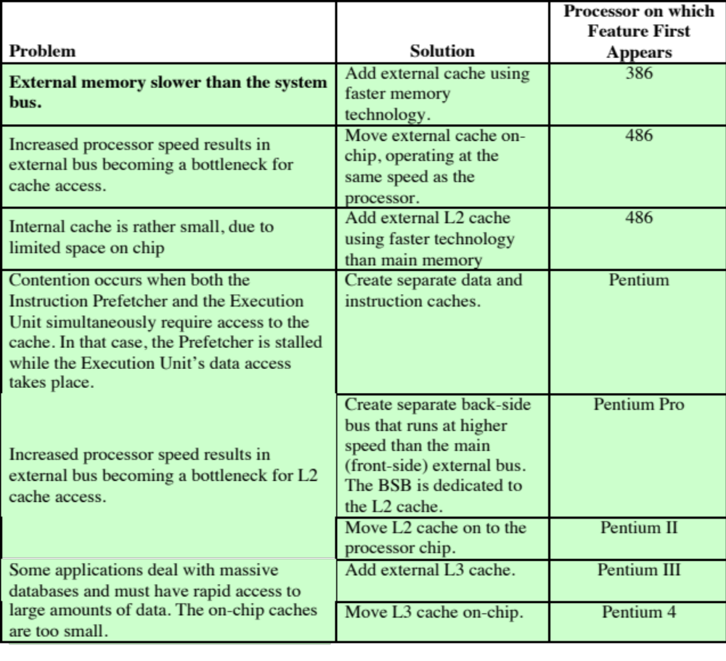
Table 4.4
Intel
Cache Evolution
Notes:
The evolution of cache organization is seen clearly in the evolution of Intel microprocessors
(Table 4.4). The 80386 does not include an on-chip cache. The 80486
includes a single on-chip cache of 8 Kbytes, using a line size of 16 bytes and a
four-way set-associative organization. All of the Pentium processors include two
on-chip L1 caches, one for data and one for instructions. For the Pentium 4, the
L1 data cache is 16 Kbytes, using a line size of 64 bytes and a four-way set-associative
organization. The Pentium 4 instruction cache is described subsequently. The
Pentium II also includes an L2 cache that feeds both of the L1 caches. The L2 cache
is eight-way set associative with a size of 512 kB and a line size of 128 bytes. An L3
cache was added for the Pentium III and became on-chip with high-end versions of
the Pentium 4.

Slide 55
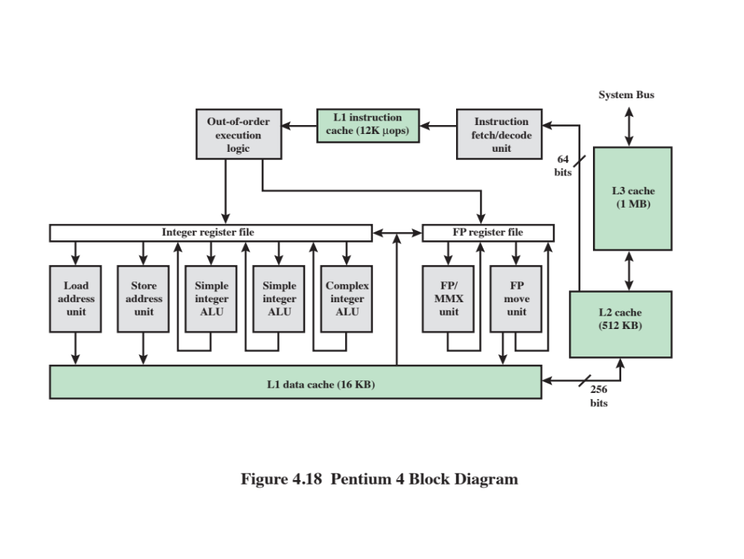
Notes:
Figure 4.18 provides a simplified view of the Pentium 4 organization, highlighting
the placement of the three caches. The processor core consists of four major
components:
• Fetch/decode unit: Fetches program instructions in order from the L2 cache,
decodes these into a series of micro-operations, and stores the results in the L1
instruction cache.
• Out-of-order execution logic: Schedules execution of the micro-operations
subject to data dependencies and resource availability; thus, micro-operations
may be scheduled for execution in a different order than they were fetched
from the instruction stream. As time permits, this unit schedules speculative
execution of micro-operations that may be required in the future.
Execution units: These units executes micro-operations, fetching the required
data from the L1 data cache and temporarily storing results in registers.
• Memory subsystem: This unit includes the L2 and L3 caches and the system
bus, which is used to access main memory when the L1 and L2 caches have a
cache miss and to access the system I/O resources.
Unlike the organization used in all previous Pentium models, and in most
other processors, the Pentium 4 instruction cache sits between the instruction
decode logic and the execution core. The reasoning behind this design decision is
as follows: As discussed more fully in Chapter 16, the Pentium process decodes, or
translates, Pentium machine instructions into simple RISC-like instructions called
micro-operations. The use of simple, fixed-length micro-operations enables the use
of superscalar pipelining and scheduling techniques that enhance performance.
However, the Pentium machine instructions are cumbersome to decode; they have a
variable number of bytes and many different options. It turns out that performance
is enhanced if this decoding is done independently of the scheduling and pipelining
logic. We return to this topic in Chapter 16.
The data cache employs a write-back policy: Data are written to main memory
only when they are removed from the cache and there has been an update. The
Pentium 4 processor can be dynamically configured to support write-through caching.

Slide 56
Pentium 4 organization, highlighting the placement of the three caches. The processor core consists of four major components:
• Fetch/decode unit: Fetches program instructions in order from the L2 cache, decodes these into a series of micro-operations, and stores the results in the L1 instruction cache
• Out-of-order execution logic: Schedules execution of the micro-operations
• Execution units: These units executes micro-operations, fetching the required data from the L1 data cache and temporarily storing results in registers
• Memory subsystem: This unit includes the L2 and L3 caches and the system bus, which is used to access main memory when the L1 and L2 caches have a cache miss and to access the system I/O resources
Notes:
Figure 4.18 provides a simplified view of the Pentium 4 organization, highlighting
the placement of the three caches. The processor core consists of four major
components:
• Fetch/decode unit: Fetches program instructions in order from the L2 cache,
decodes these into a series of micro-operations, and stores the results in the L1
instruction cache.
• Out-of-order execution logic: Schedules execution of the micro-operations
subject to data dependencies and resource availability; thus, micro-operations
may be scheduled for execution in a different order than they were fetched
from the instruction stream. As time permits, this unit schedules speculative
execution of micro-operations that may be required in the future.
Execution units: These units executes micro-operations, fetching the required
data from the L1 data cache and temporarily storing results in registers.
• Memory subsystem: This unit includes the L2 and L3 caches and the system
bus, which is used to access main memory when the L1 and L2 caches have a
cache miss and to access the system I/O resources.
Unlike the organization used in all previous Pentium models, and in most
other processors, the Pentium 4 instruction cache sits between the instruction
decode logic and the execution core. The reasoning behind this design decision is
as follows: As discussed more fully in Chapter 16, the Pentium process decodes, or
translates, Pentium machine instructions into simple RISC-like instructions called
micro-operations. The use of simple, fixed-length micro-operations enables the use
of superscalar pipelining and scheduling techniques that enhance performance.
However, the Pentium machine instructions are cumbersome to decode; they have a
variable number of bytes and many different options. It turns out that performance
is enhanced if this decoding is done independently of the scheduling and pipelining
logic. We return to this topic in Chapter 16.
The data cache employs a write-back policy: Data are written to main memory
only when they are removed from the cache and there has been an update. The
Pentium 4 processor can be dynamically configured to support write-through caching.

Slide 57
Pentium 4 Cache
80386 – no on chip cache
80486 – 8k using 16 byte lines and four way set associative organization
Pentium (all versions) – two on chip L1 caches
  Data & instructions
Pentium 4 – L1 caches
  8k bytes
  64 byte lines
  four way set associative
L2 cache
  Feeding both L1 caches
  256k
  128 byte lines
  8 way set associative

Slide 59
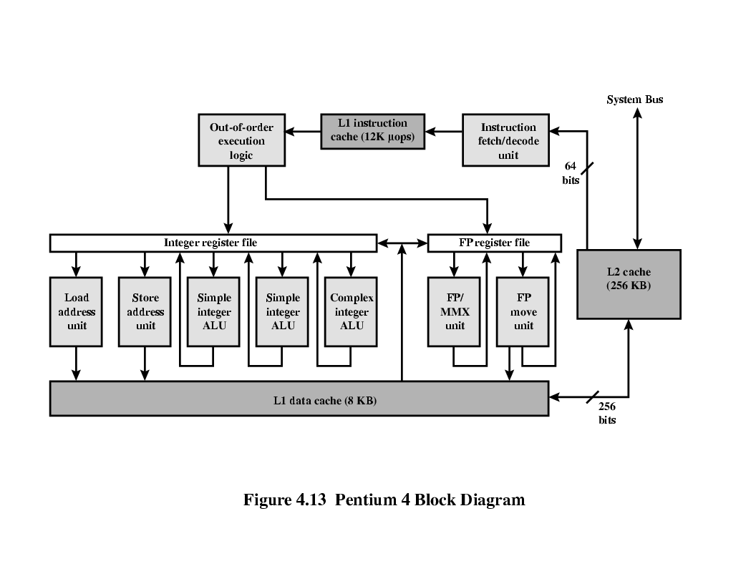
Pentium 4 Core Processor
Fetch/Decode Unit
  Fetches instructions from L2 cache
  Decode into micro-ops
  Store micro-ops in L1 cache
Out of order execution logic
  Schedules micro-ops
  Based on data dependence and resources
  May speculatively execute
Execution units
  Execute micro-ops
  Data from L1 cache
  Results in registers
Memory subsystem
  L2 cache and systems bus

Slide 60
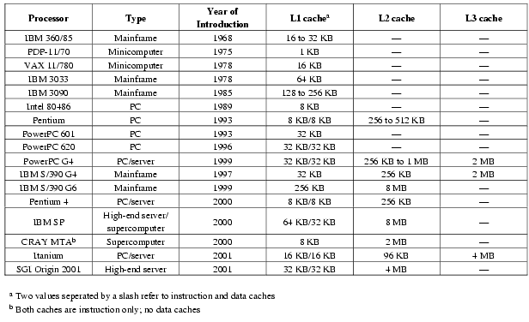
Comparison of Cache Sizes

